Slide 1

Restaurant Reservation and Recommendation System DMDD project Group Name: R3
Group Members:
Anjali Kshirsagar (002743547)
Gayatri Kenkare (002743776)
Snehal Padekar (002737903)
Mahek Gangadia (002797094)

Slide 2
Description:
A restaurant recommendation and reservation system is the goal of the project. It serves as a forum for food enthusiasts.
The algorithm will consider the user's food preferences and then make recommendations for good restaurants in close surroundings.
This advice will only take into account factors like price, food quality, ratings from previous customers, accessibility, ambiance, etc.
After selecting the restaurant, the user can make a table reservation. The reservation system includes options for making reservations at particular restaurants, canceling reservations, changing reservation details, etc.
This system's goal is to give users suggestions for the best restaurants in their area. This system can give people some suggestions; also you can get others' opinions from this site.
By evaluating restaurants, you can suggest diners to other people in addition to browsing others' reviews.
There are various methodologies for searching restaurants in this system, including searching by zip code, kind, keyword, price, and recommendations.

Slide 3
Scope and Motivation
Motivation:
Being international students, we have a hard time finding a decent restaurant that is both within our budget and conveniently located. As a result, we had the idea to build a system where users could check out a restaurant's menu and other details and reserve a table. Making a recommendation system will help users find a good restaurant within their budget.
Scope:
The user can browse through the restaurants and view the reviews. They can post reviews for the restaurant after logging in or signing up for the system. The project offers two primary features. The recommendation module comes first, followed by the reservation module. The project's scope is limited to just the eateries in Boston City. The recommendation module will be able to respond to a variety of user inquiries, like "A decent restaurant serving Burgers", The reservation module offers a variety of features, including the ability to reserve a table at a restaurant, cancel a reservation, or check for review for any restaurant.

Slide 4
Source of Data for our Database:
We scraped information about restaurants from Google.
To scrape data, Selenium and Chrome web drivers were utilized.
Data has been scraped from three sources.
1. Google
2. Food Menu Prices Website
3. Kaggle
Google is the first source, and the website food menu prices are the second. The restaurant data was directly taken from Google. Google will look up the restaurant, and information on the closest restaurants will be collected.
The information about the restaurant, such as the review, the type of restaurant, the address, the phone number, the hours of operation, etc.
The information, including meal categories, items, and their costs, is scraped from a website's food menu prices. Both websites’ data is real-time and extremely accurate.
The information is dynamic and valid. The third source is Kaggle. We have taken a few datasets from Kaggle related to user comments and restaurant reservation details.

Slide 5
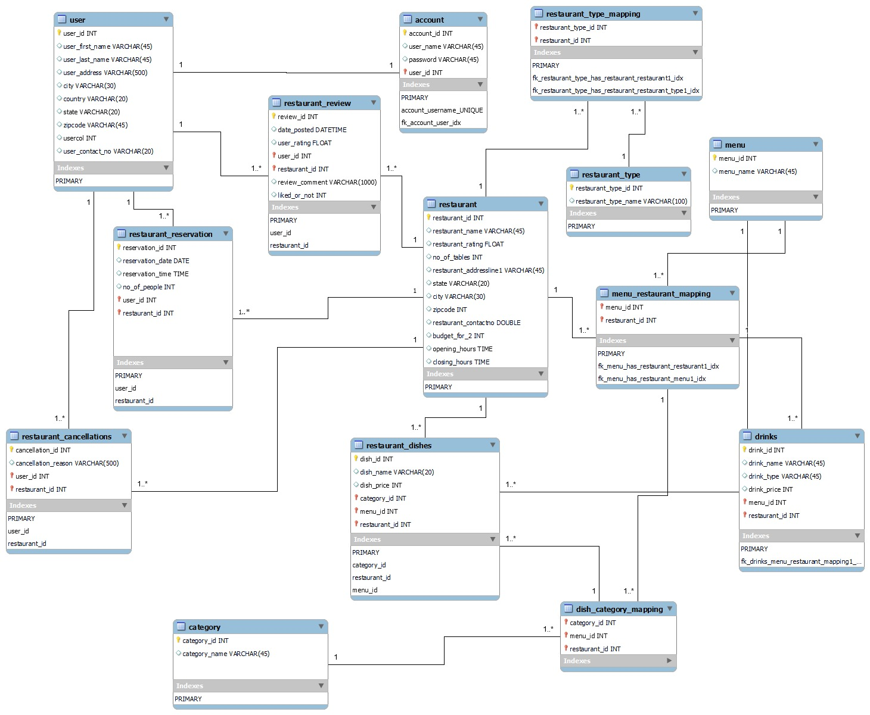
Physical Model:

Slide 6
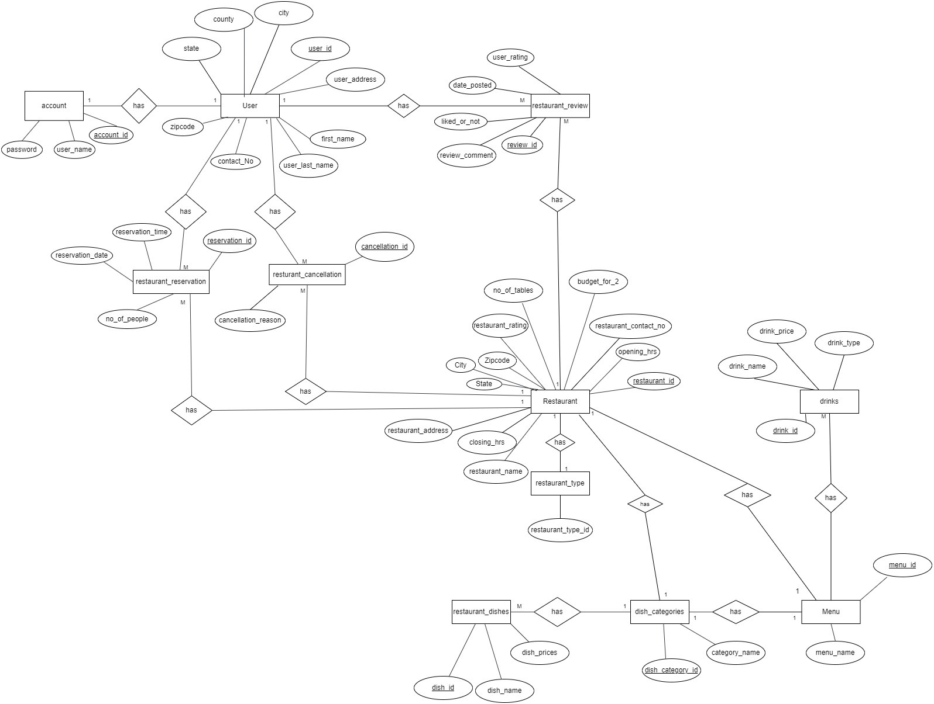
ER Diagram:

Slide 7
Tables Created for this system:
restaurant
restaurant_type
restaurant_type_mapping
account
menu
menu_restaurant_mapping
user
Restaurant_dishes
drinks
category
dish_category_mapping
restaurant_review
restaurant_reservation
restaurant_cancellation

Slide 8
Views Created for this system
Dishprice
Drinktable
rescategory
restype
Userrating

Slide 9
Stored Procedures and Triggers Created for this system
Searchby_budget
Searchby_category
Searchby_dishname
Searchby_dishprice
Searchby_drinktype
Searchby_rating
searchby_resturant_name
Searchby_restype
searchby_userrating
Searchby_zip
add_review_restaurant
restaurant_reservation
Restaurant_cancellation
Updatenooftables (Trigger)
Updatenooftables1 (Trigger)

Slide 10
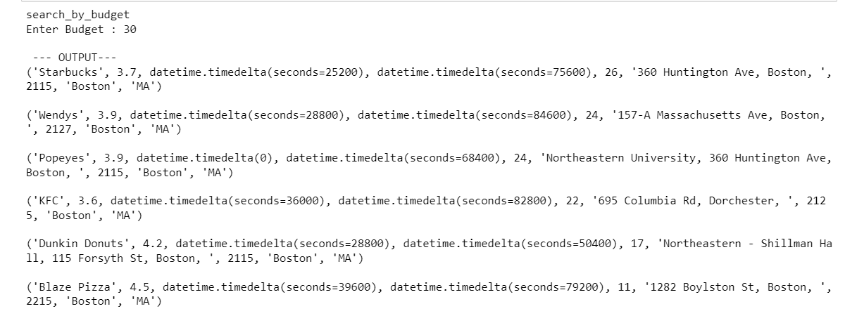
Features:
1. Search for a Restaurant:
a) Search by budget

Slide 11
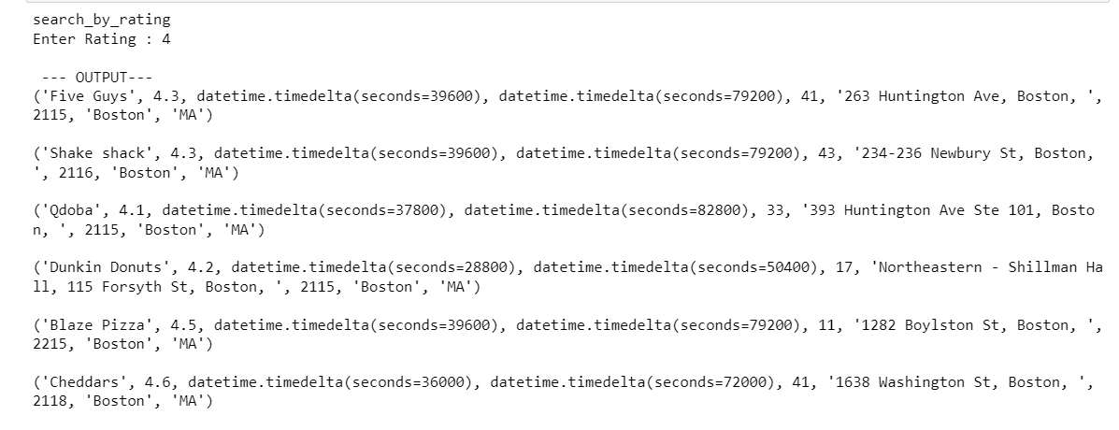
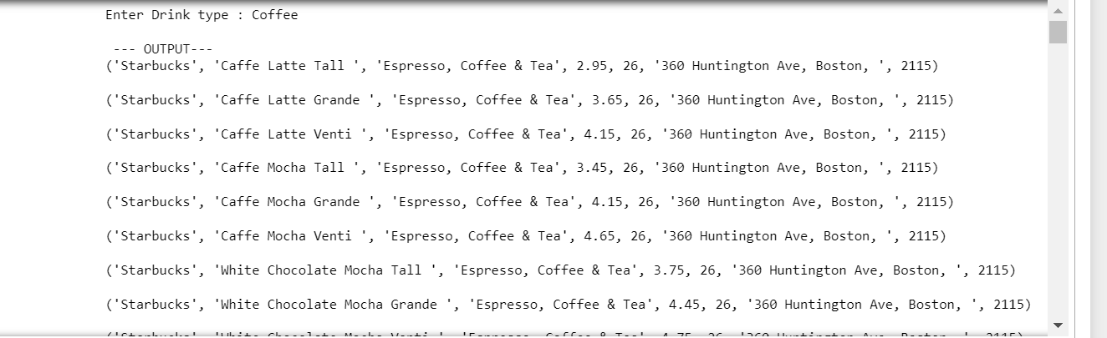
b) Search by rating
c) Search by drink type

Slide 12
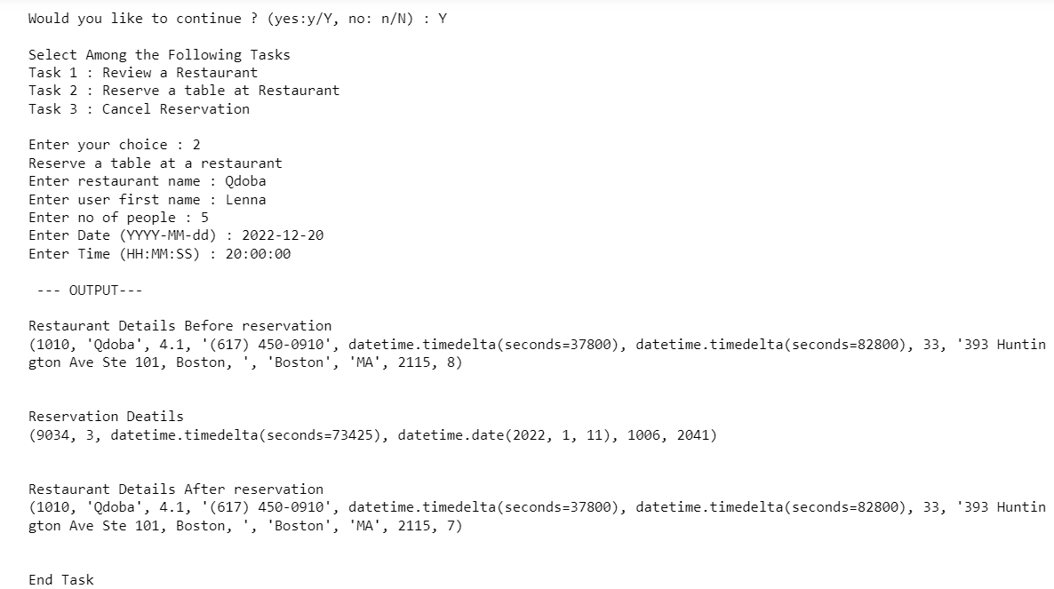
2. Make a Reservation:

Slide 13
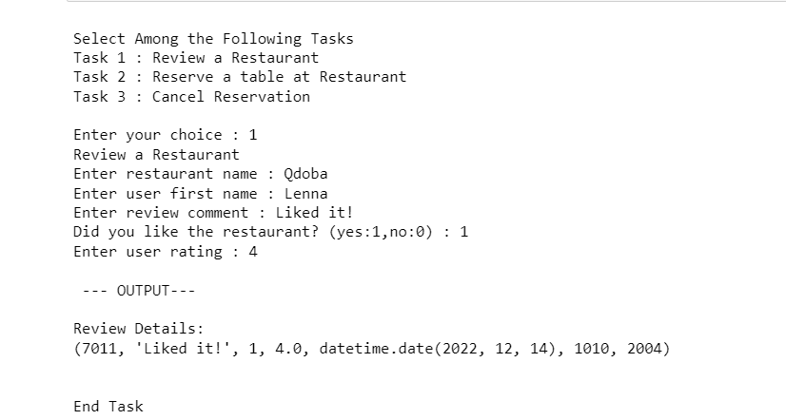
3. Give a Review for a Restaurant

Slide 14
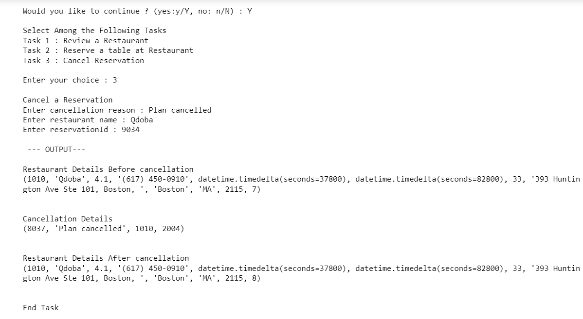
4. Cancel the Reservation

Slide 15
Conclusion
The proposed Restaurant Reservation and Recommendation system fulfills all the requirements of the user like searching for a restaurant, restaurant reservation and cancellation of any reservation made for the restaurants in Boston city. Thus the system allows users to easily browse through the system and check for any specific requirements he has and get restaurant details accordingly.

